Slide 1



Under Sampling and Over Sampling
BALANCING DATA FOR BETTER PERFORMANCE
01
02
03
04
September 2024
Vignan University
Y. Pranay Kumar, ACSE-CS
05

Slide 2

Importance of Data Balance in Machine Learning
In machine learning, balanced data is crucial because it ensures that models learn equally from all classes. When data is imbalanced, models may become biased, favoring the majority class and leading to poor predictions for the minority class.
This can be a significant issue in fields like fraud detection or medical diagnosis, where accurate predictions for all classes are critical. Balancing data helps improve model accuracy, fairness, and reliability.
01
02
03
04
05

Slide 3

Techniques to address Imbalanced Data
01. Under Sampling
Reduces the number of examples in the majority class to match the minority class, making the dataset balanced but possibly losing valuable information.
02. Over Sampling
Increases the number of examples in the minority class by duplicating data or creating synthetic samples, which helps balance the dataset but can lead to overfitting.
01
02
03
04
05

Slide 4
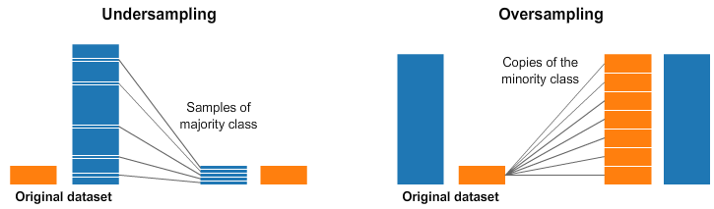
Under Sampling
01. Definition
02. Techniques
Reduces the number of examples in the majority class to match the minority class, making the dataset balanced but possibly losing valuable information.
Common methods include:
Random Under Sampling
Tomek Links
Cluster Centroids
03. Advantages
04. Disadvantages
Simplifies the dataset, reduces computational cost, and can improve model performance on minority class.
May lose important data from the majority class, potentially leading to underrepresentation and loss of valuable information.
01
02
03
04
05

Slide 5
Over Sampling
01. Definition
02. Techniques
Over sampling increases the size of the minority class by adding more samples, either by duplicating existing ones or generating new synthetic data.
Common methods include:
Random Over Sampling
SMOTE
ADASYN
03. Advantages
04. Disadvantages
Ensures the minority class is well-represented, leading to better model accuracy and more balanced predictions.
Can cause overfitting due to repeated or synthetic data and may increase computational costs due to the larger dataset.
05
06
07

Slide 6
Large datasets may make over sampling computationally expensive, while under sampling might lead to a loss of valuable information in smaller datasets.
01
Challenges &
Considerations
Over sampling can significantly increase the dataset size, requiring more memory and processing power, which might not be feasible in all environments.
02
It can be challenging to select the appropriate sampling method, as each has its strengths and weaknesses depending on the dataset and problem.
03
Over sampling, especially with synthetic data, can lead to overfitting, where the model performs well on training data but poorly on new, unseen data
05
06
07

Slide 7
Thank You
FOR YOUR ATTENTION
05
06
Y. PRANAY KUMAR, ACSE-CS
07

